Slide 1

DWH Project Report
From My-Hanh Dang & Daniel Strässle

Slide 2
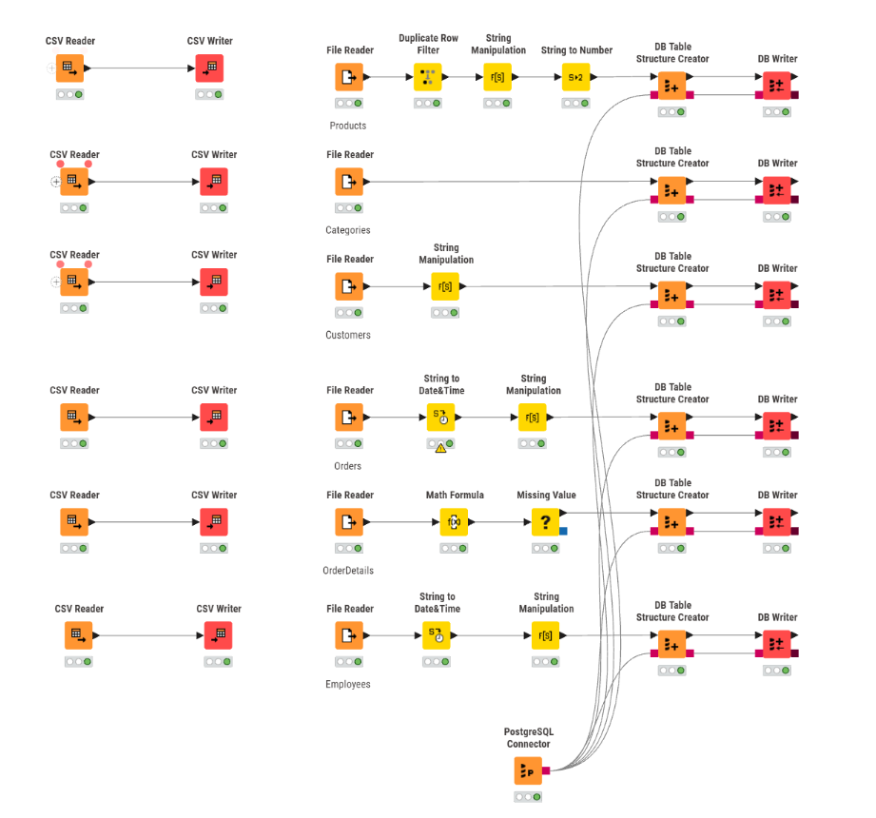
Staging Area
Integrated six CSV datasets: Products, Categories, Customers, Orders, OrderDetails, Employees
ETL workflow implemented in KNIME
Cleaned data loaded into PostgreSQL
ETL Workflow & Data Preparation
File Reader / CSV Reader: Imported raw datasets
Encoding conversion: Standardized file encodings for correct text processing
Duplicate Row Filter: Removed duplicate entries in Products
String Manipulation: Cleaned and formatted text fields
String to Number: Converted numeric columns to correct data types
String to Date&Time: Standardized inconsistent date formats (Orders, Employees)
Math Formula: Corrected negative discount values (OrderDetails)
Missing Value: Handled NULL values appropriately
Data Loading
DB Table Structure Creator: Defined tables with meaningful data types
DB Writer: Loaded cleaned data into PostgreSQL
Outcome
Clean, consistent, and structured staging tables
Improved data quality and integrity
Reliable foundation for the Data Mart and analysis

Slide 3
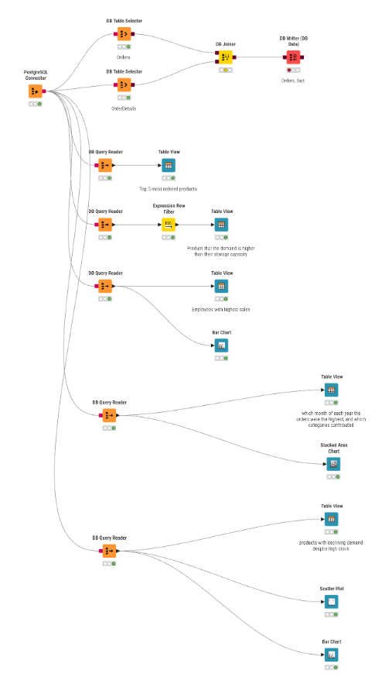
Data Mart
Data Mart built from cleaned staging tables in PostgreSQL
Designed to support analytical queries and reporting
Data Integration & Modeling
PostgreSQL Connector: Access to staging tables
DB Table Selector: Selected relevant tables (Orders, OrderDetails)
Joiner: Combined tables to create a central fact table (Orders_fact)
Structured data model optimized for analysis (fact-based design)
Analysis Workflow (KNIME)
DB Query Reader: Executed SQL queries for analysis
Expression Row Filter: Applied conditions (e.g., demand vs. stock)
Table View: Displayed query results
Bar Chart / Stacked Area Chart / Scatter Plot: Visualized key insights
Outcome
Efficient querying and analysis-ready structure
Clear insights through visualizations
Supports business-oriented decision making

Slide 4
Data Modeling (Star Schema)
The Data Mart is designed using a Star Schema
Central Fact Table stores measurable data (e.g., sales, quantity)
Surrounding Dimension Tables provide descriptive context
Structure enables fast queries and easy analysis
Schema Components
Fact Table: Orders_fact
Dimensions:
Products (Product details)
Customers (Customer info)
Employees (Sales staff)
Categories (Product categories)
Products
Customers
Orders_fact
Categories
Employees

Slide 5
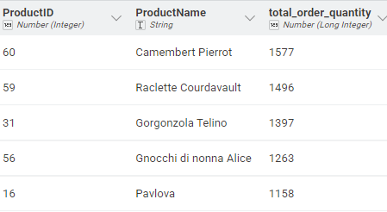
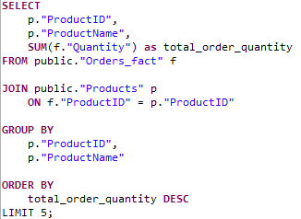
Which top five 5 products are ordered the most?
Identified using an SQL query on the Orders_fact table
Joined with Products to retrieve product names
Aggregated total quantity using SUM(Quantity)
Sorted in descending order and limited to top 5
Results:
Insight:
Important for inventory planning and sales strategy

Slide 6
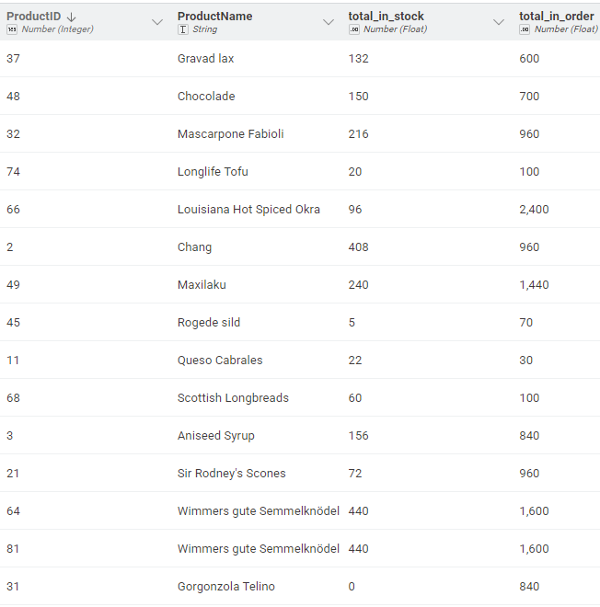
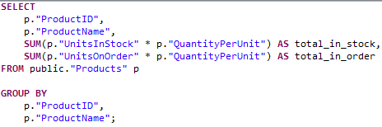
Which products have higher demand than products in stock?
Results:
SUM(UnitsInStock * QuantityPerUnit) → calculates total stock capacity
SUM(UnitsOnOrder * QuantityPerUnit) → calculates total demand
GROUP BY ProductID, ProductName → aggregates results per product
Products where demand > stock were identified afterward in KNIME using a filter
Insight
These products should be prioritized for supply chain optimization

Slide 7
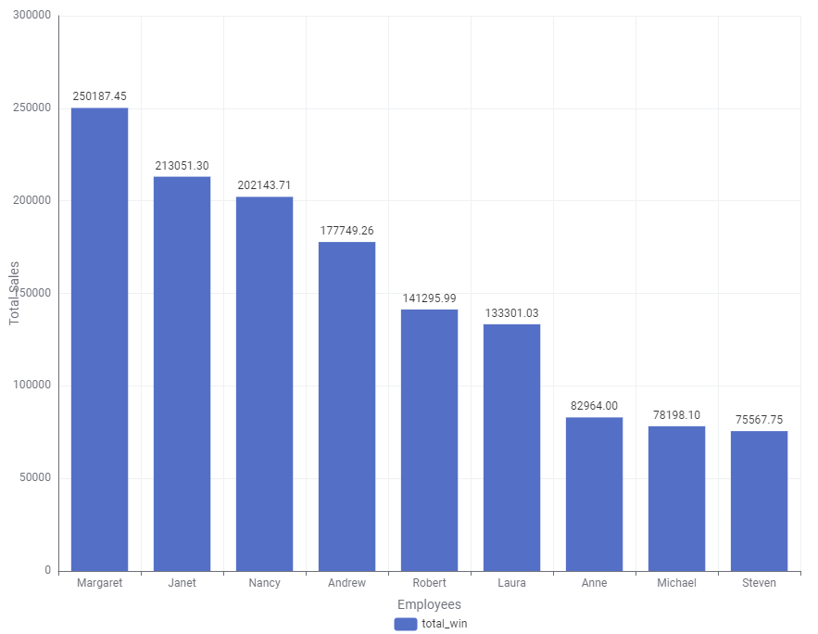
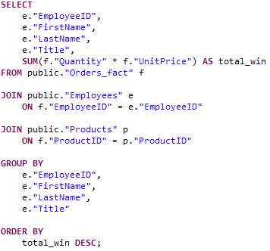
Which employee has the highest sales?
Identified using an SQL query on Orders_fact
Joined with Employees and Products tables
Calculated total sales using SUM(Quantity × UnitPrice)
Results sorted in descending order
Results:
Insight
Significant performance differences between employees
Top performers can be analyzed for best practices and sales strategies

Slide 8
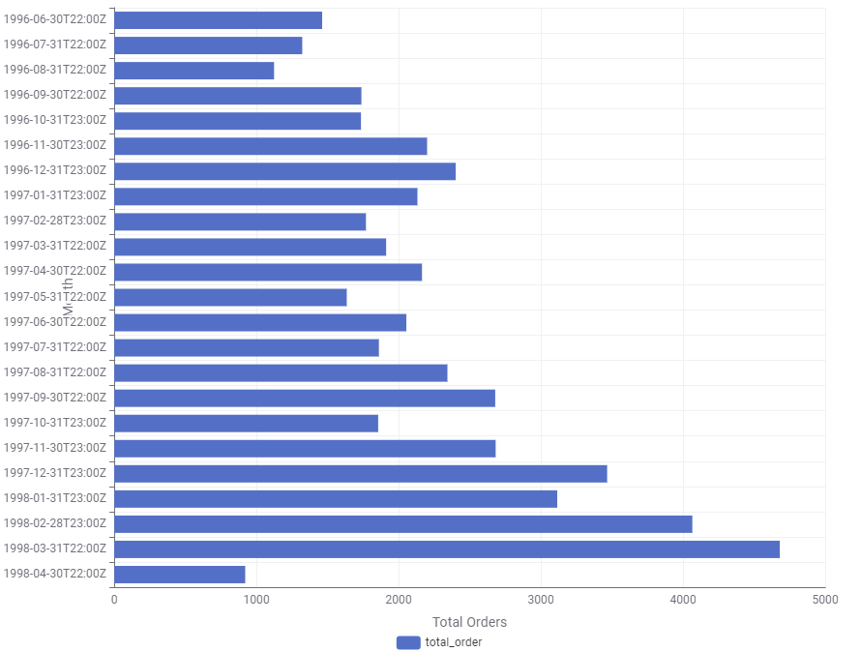
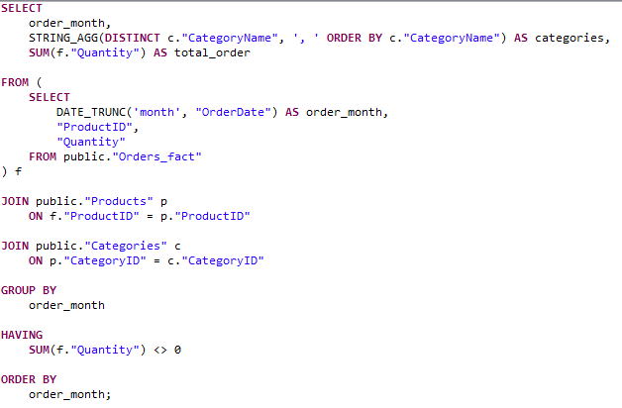
In which month of each year the orders were the highest, and which categories contributed?
Results:
Identified using an SQL query on Orders_fact
Joined with Products and Categories
Aggregated orders per date using SUM(Quantity)
STRING_AGG(DISTINCT CategoryName, …) → Lists unique categories per month
Insight
Seasonal trend with higher demand toward year-end in 1996 & 1997
Useful for seasonal inventory planning and marketing campaigns
Key categories driving peaks should be prioritized during high-demand periods

Slide 9
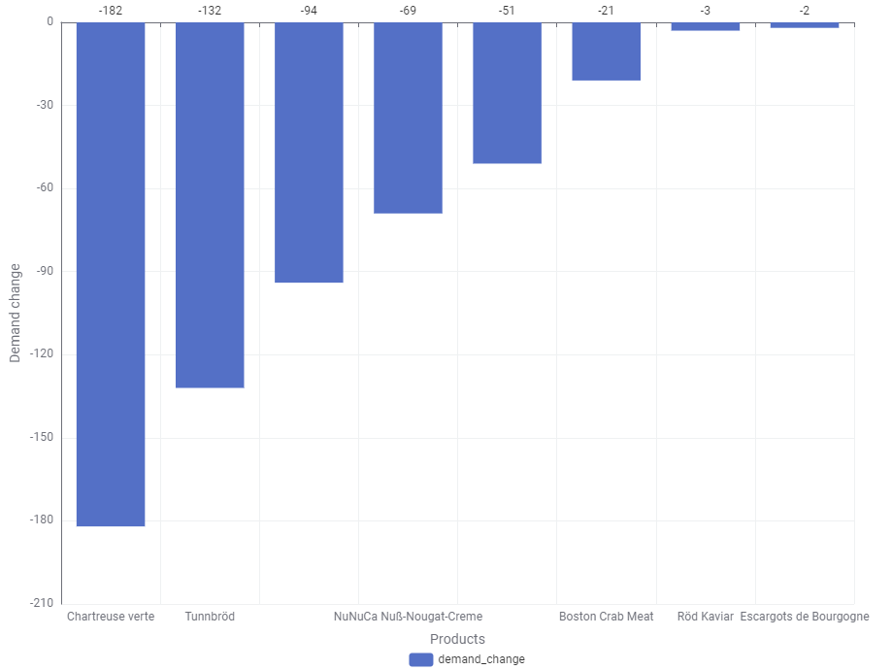
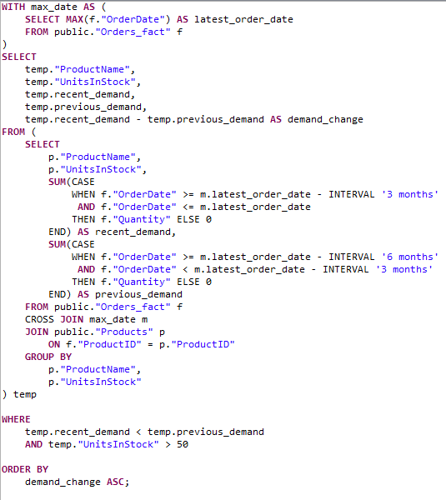
Which products show declining demand despite high stock?
Identified using SQL on Orders_fact and Products
Compared recent demand (last 3 months) vs. previous period
Filtered products with decreasing demand and high stock (> 50 units)
Results:
Insight
Some products show declining demand despite high inventory
Indicates risk of overstock and increased storage costs
Suggests need for discounts, promotions, or stock reduction strategies

Slide 10
Experiences & Conclusions
Experiences
Gained practical experience in building a Data Warehouse (Staging Area + Data Mart)
Worked with KNIME for ETL and PostgreSQL for data storage
Learned to handle data quality issues (duplicates, formats, missing values, encoding)
Cleaned data made joins easier and more reliable
Applied SQL and Star Schema modeling for analysis
Conclusions
Clean and structured data is essential for accurate results
The Data Mart improves query performance and usability
Visualizations are highly effective for analyzing and communicating insights
Data analysis revealed key business insights (e.g., demand trends, stock issues)
Supports data-driven decision making

